Slide 1
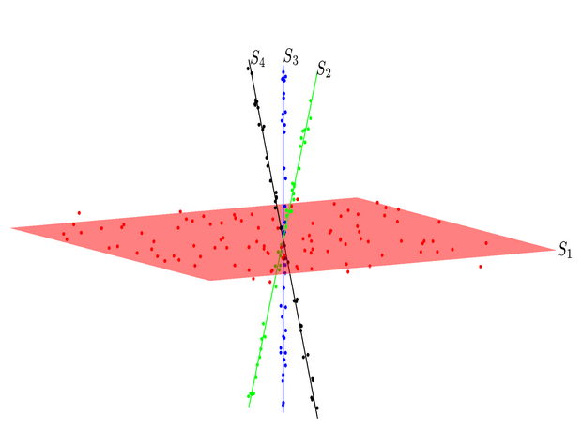
Robust Subspace Clustering M. Soltanolkotabi E.Elhamifar E.J. Candes
报告人：万晟、元玉慧、张驰昱
信息科学与技术学院
智能科学系

Slide 2
1. Main Contribution

Slide 3
Existing work
Subspace Clustering
Def. Find a multi-subspace representation that best fits a collection of points taken from high-dimensional space.
Existing Algorithms (four main categories)
-1- Iterative methods (K-subspaces)
-2- Algebraic approaches (Factorization-based)
-3- Statistical methods (mixtures of probabilistic PCA)
-4- Spectral clustering-based methods (Local subspace affinity)

Slide 4
Existing work
Sparse subspace clustering(SSC)
Under mild assumptions, the sparse representation cat be solved efficiently using minimization.

Slide 5
Paper’s Work
On noisy data, the paper proposed a statistical mixture model to represent data lying near a union of subspaces.
Problem Model:
Data points x from
L subspaces : dimensions:
Goal: given N data points , approximate the underlying subspaces .

Slide 6
Paper’s Work
Basics: y = x + z
Clustering fundamental factors :
The distance/affinity between subspaces
Sampling density

Slide 7
Paper’s Work
Sparse Subspace Clustering General Structure
1. Construct affinity matrix W between samples producing
a weighed graph.
2. Construct clusters by applying spectral clustering to W
3. Apply PCA to each cluster.

Slide 9
Performance metrics
False discoveries: and not belong to the same subspace
True discoveries: and belong to the same subspace
Goal: no false discoveries and many true discoveries

Slide 10
Sparse Regression strategy Lasso
True discoveries Number [0.5d, 0.8d]

Slide 11
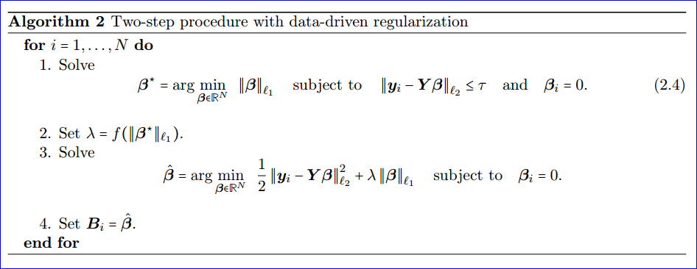
Sparse Regression strategy two-step procedure
Solving 2 lasso for each data point and is useful when dimensions are some very large some low.

Slide 12
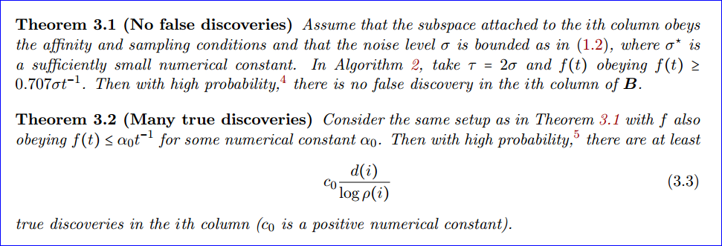
Sparse Regression strategy two-step procedure

Slide 13
Sparse Regression strategy Bias-corrected Dantzig Selector
Dantzig Selector
Biased Dantzig Selector
Choice of parameter:

Slide 14
2. Proof of main results

Slide 15
Proof: notation

Slide 16
Proof: intermediate results

Slide 17
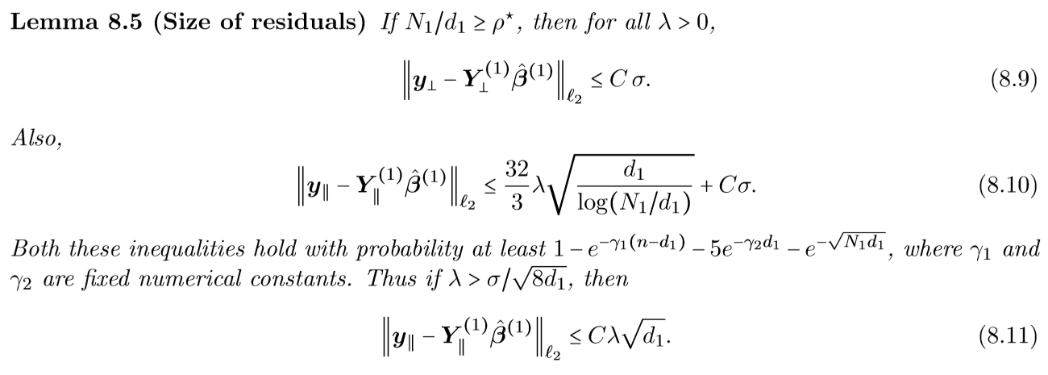

Slide 18
Proof: Theorem 3.1

Slide 19
Proof: Theorem 3.1

Slide 20
Proof: Theorem 3.2

Slide 21
3. experiment

Slide 22
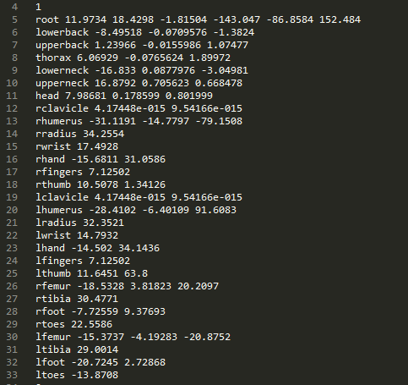
1、数据预处理
半结构化数据
降低采样率

Slide 23
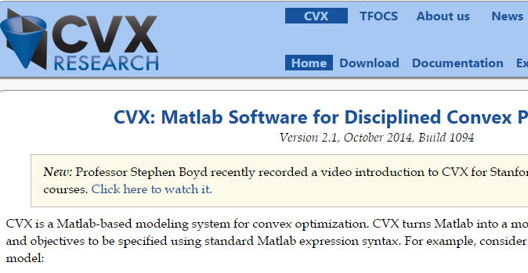

Slide 24
3、计算对称邻接矩阵（KNN）
4、谱聚类
squad
stand
lift_arm
jump
drink
punch
walk
jog
walk
walk

